Slide 1
Puviyarasan V K
NM Project

Slide 2
PROJECT TITLE
FAKE NEWS DETECTION USING MACHINE LEARNING

Slide 3


AGENDA
PROBLEM STATEMENT
PROJECT OVERVIEW
WHO ARE THE END USERS?
SOLUTION AND ITS VALUE PROPOSITION
MODELLING
RESULTS
3/21/2024 Annual Review

Slide 4

PROBLEM STATEMENT
The proliferation of fake news in Indian politics poses a significant threat to the integrity of information dissemination and public discourse. The deliberate spread of false propaganda through deceptive narratives has adversely affected the mindset of the populace, leading to potential social unrest and political polarization. Traditional methods of discerning fake news based on content alone have proven inadequate in the face of sophisticated disinformation campaigns. In response to this pressing issue, there is an imperative need to develop robust mechanisms for verifying the authenticity of news articles. Leveraging machine learning techniques, particularly through the vectorization of news titles and analysis of word tokens, offers a promising avenue for detecting fake news with greater accuracy and efficiency.

Slide 5

PROJECT OVERVIEW
The proliferation of fake news within the realm of Indian politics has become a formidable challenge, undermining the integrity of information dissemination and influencing public opinion. Traditional methods of detecting fake news based solely on content analysis have proven insufficient in the face of sophisticated disinformation tactics. Therefore, there is a critical need for innovative approaches to combat the spread of false narratives and ensure the credibility of news sources.
This project proposes the application of machine learning techniques to address the issue of fake news detection. By leveraging advancements in natural language processing (NLP) and supervised learning algorithms, the project aims to develop a model capable of accurately classifying news articles as either genuine or fake based on their textual content.

Slide 6
WHO ARE THE END USERS?
General Public: Individuals seeking to verify the authenticity of news articles related to Indian politics before sharing or acting upon them.
Media Organizations: News outlets and platforms ensuring credibility by integrating the fake news detection model into their editorial processes.
Fact-Checking Organizations: Streamlining verification processes by utilizing the fake news detection model for initial screening of news articles.
Social Media Platforms: Reducing the spread of false information by integrating the fake news detection model to flag or filter out fake news content.

Slide 7

YOUR SOLUTION AND ITS VALUE PROPOSITION
Our solution leverages machine learning techniques, specifically natural language processing (NLP) algorithms, to develop a robust fake news detection model tailored to the context of Indian politics. By analyzing textual content from news articles and employing advanced feature extraction methods, our model can accurately classify articles as either genuine or fake.
Accuracy and Efficiency: Our model offers high accuracy in detecting fake news, providing users with reliable information to make informed decisions about the content they consume and share. By automating the process, it significantly reduces the time and effort required for manual verification.
Combatting Misinformation: By empowering users to distinguish between genuine and fake news articles, our solution helps combat the spread of misinformation in Indian politics. This contributes to fostering a more informed and resilient society, safeguarding the integrity of public discourse.

Slide 8
YOUR SOLUTION AND ITS VALUE PROPOSITION
Enhanced Trust and Credibility: Media organizations, fact-checkers, and social media platforms can integrate our fake news detection model to enhance trust and credibility with their audience. By ensuring the authenticity of the content they publish or allow on their platforms, they uphold journalistic standards and mitigate reputational risks.
Educational Empowerment: Educational institutions can utilize our solution to educate students about media literacy and critical thinking skills. By incorporating the fake news detection tool into their curriculum, they empower the next generation to navigate the digital information landscape responsibly and discern fact from fiction.
Government Oversight: Government agencies responsible for regulating media and information dissemination can utilize our solution to monitor and combat the spread of misinformation. By leveraging automated tools for detecting fake news, they enhance their capacity to safeguard public discourse and democratic processes.

Slide 9

THE WOW IN YOUR SOLUTION
Timely Interventions: The system enables timely interventions by alerting healthcare providers to potential medical conditions before they escalate, thereby reducing the risk of complications and improving patient prognosis.
Improved Patient Outcomes: By facilitating early detection and timely interventions, the system contributes to improved patient outcomes, including faster recovery times, reduced hospitalizations, and better overall health outcomes.
Enhanced Healthcare Efficiency: The predictive model streamlines the diagnostic process and optimizes resource allocation within healthcare facilities, leading to improved efficiency and cost-effectiveness in healthcare delivery.
3/21/2024 Annual Review
9

Slide 10
MODELLING
Data Collection: Gather a comprehensive dataset of news articles related to Indian politics, labeled as either genuine or fake. Ensure the dataset is balanced and representative of the types of articles encountered in real-world scenarios.
Data Preprocessing: Clean the dataset by removing any irrelevant or duplicate articles. Perform text preprocessing techniques such as tokenization, removing stop words, and stemming or lemmatization to standardize the text data.
Feature Extraction: Transform the text data into numerical features that can be used for modeling. Common approaches include TF-IDF (Term Frequency-Inverse Document Frequency) vectorization, word embeddings (e.g., Word2Vec), or document embeddings (e.g., Doc2Vec).
10

Slide 11
MODELLING
Model Selection: Choose appropriate machine learning algorithms for classification tasks. Common choices include logistic regression, support vector machines (SVM), decision trees, random forests, and neural networks. Consider ensemble methods for improved performance.
Model Training: Split the dataset into training and testing sets. Train the selected models on the training data, optimizing hyperparameters using techniques such as cross-validation. Evaluate the models' performance on the testing set using metrics like accuracy, precision, recall, and F1-score.
Model Evaluation: Compare the performance of different models to identify the most effective approach for fake news detection in Indian politics. Consider factors such as computational efficiency, interpretability, and scalability.
11

Slide 12
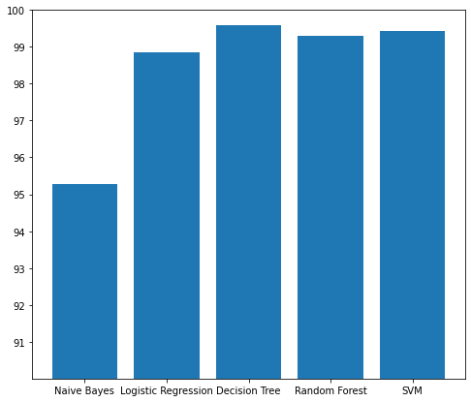
RESULTS
As we concluded that decision tree is our best model for this project
https://github.com/puviyarasanvk/NM-project/blob/main/FakeNewsDetection.ipynb
12

Slide 13
Thank you

